Slide 1
MOBILE PHONE PHOTOGRAPHY

Slide 2
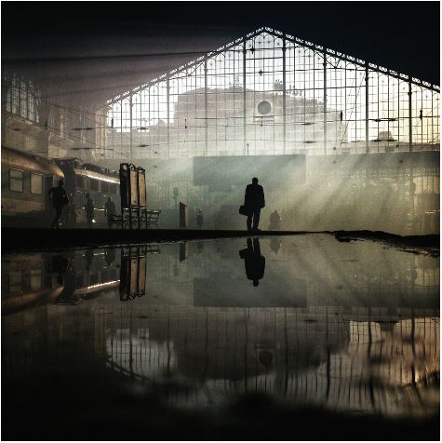

Slide 3
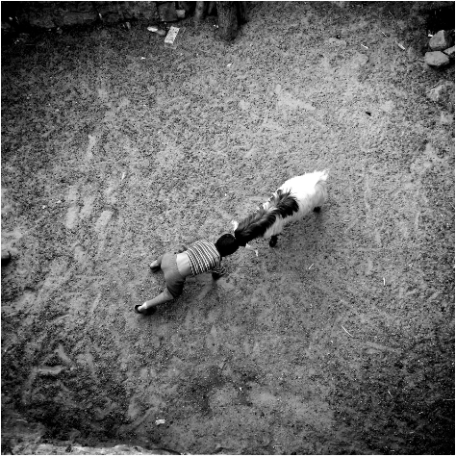

Slide 4
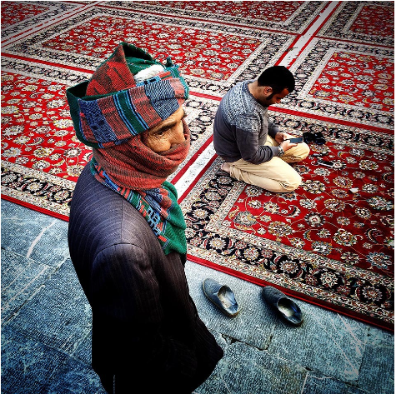

Slide 5
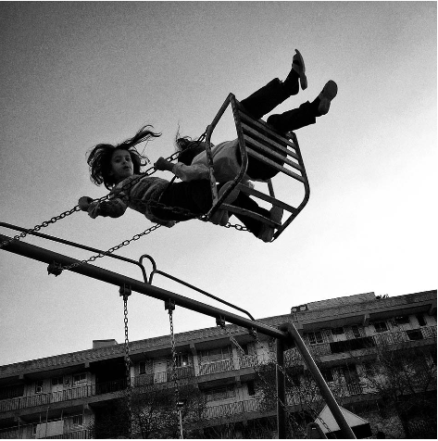

Slide 6
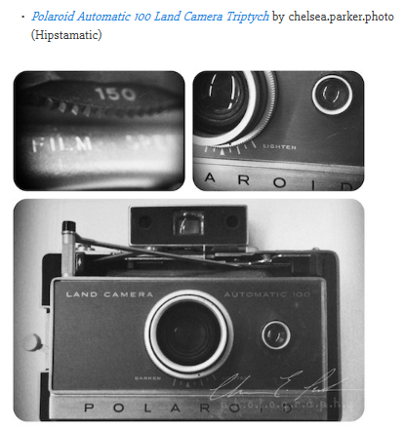

Slide 7
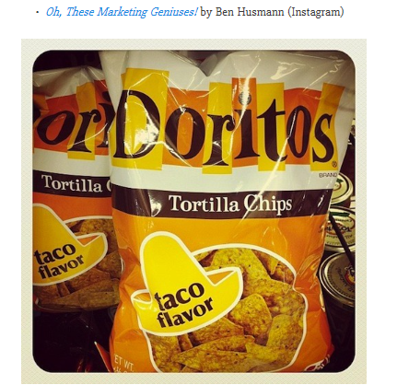

Slide 8
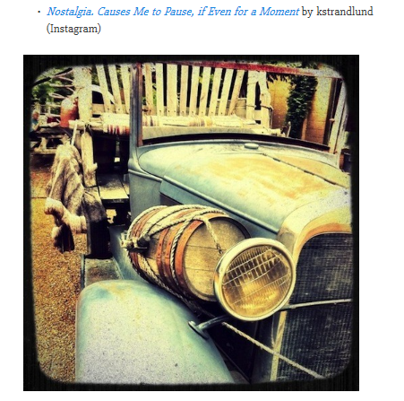

Slide 10
WHAT IS THE BEST CAMERA

Slide 11
WHAT IS THE BEST CAMERA
SIMPLY THE ONE IN YOUR HAND
YOUR SMARTPHONE

Slide 12
History of Mobile Photography
First public mobile call was made 3rd April 1973 which was made by Motorola

Slide 13
Advent of the Smartphone
The original smartphone
In 1993, Bellsouth and IBM announced their creation of the Simon personal communicator phone, touted as the world's first smartphone. Simon was designed to be a cellphone first and a computer second, according to the product's media release.
The device, with a $899 suggested pricetag, boasted such features as:
A pager.
E-mail.
A stylus for writing on the screen, with handwriting reflected as-is for faxes.
A complete keypad featuring letters and numbers.
A calendar that could be updated automatically from a remote computer.
Only 2,000 of the devices, which weighed less than 0.5 kilograms, were made.

Slide 14
Camera phones
In 2002, the first phones with built-in cameras became publicly available, including the Nokia 7650 and the Sanyo SPC-5300.
The Nokia phone boasted "a large 176x208 pixel colour display," according to a media release at the time. The Sanyo version offered three user-controlled tones, white balance and zoom.

Slide 15
Todays Smartphone
Iphone 7 – 12MP & 7MP camera, with face detection, image stabilisation, Video, flash, HDR and more
Galaxy – F1.7, 12MP face detection, motion panorama and more

Slide 16
So your camera
Photographer Chase Jarvis said that, “The best camera is the one that’s with you” – so why not use your smartphone or tablet camera more often? There are restrictions on smartphone cameras over their DSLR or mirrorless camera brethren – their low light and AF performance still have quite a lot of catching up to do, the lenses cannot be changed, and you also have far less control over what settings (ISO, shutter speed, aperture) are used. But it is also these very restrictions that can help you improve your photography when you are using your DSLR, mirrorless, and even compact cameras.

Slide 17
TIPS

Slide 18
Be Ready!
Try to always keep your phone in camera mode so that when I unlock it, it’s ready for taking pictures. A good moment is so easy to lose. There can be no excuses such as, “Oh, your phone is somewhere in your bag,” because we are talking about MOBILE photography. Your phone should always in hand.
It may be an obvious thing to say, but nevertheless, you should remember to charge your phone and to keep your lens clean. Carry a charger with you most of the time to use if I’m having coffee in some nice cafe, but the charger won’t save you in the forest.
Switch your phone to airplane mode. Not only does it help save the phone’s battery, but it also eliminates distractions and forces you to focus on photography.

Slide 19
Don’t think twice, take pictures whenever you want and of whatever you wish!
If you doubt whether to take a picture or not — take it! Snap it! Some moments will not be repeated. If you don’t like your picture you can always delete it, but if you had lost the moment you wouldn’t be able to turn back time and catch it. Don’t overthink and hesitate because there’s nothing to lose.

Slide 20
Light is the answer!
Let’s not forget that photography is all about using light. Even the most boring composition will be saved by the good light no matter if it’s a day or evening.

Slide 21
Learn the technical peculiarities of your phone camera
Find out the strong and weak sides of your phone.
Don’t be lazy, read the manual and make sure you’re using your phone in the most efficient circumstances. We may be self-confident and think that we know-it-all, but sometimes little tips in the manual can help us to improve our photos in a big way.
Learn how you can control the exposure, or focus on the objects better.

Slide 22
Don’t use zoom!
I think this is the first step towards taking a bad smartphone picture. If you want to zoom in on something, use your legs and move! Don’t forget that this is just a phone, and its opportunities are not those of a DSLR lens.

Slide 23
Select and retouch!
Be selective! Try to choose only the best pictures and then edit those.
There are many apps that will help you to do this, and while we can’t understate their help in creating beautiful images, but don’t try too hard. You should remember that sometimes a picture can be better off without any filters.
It’s also worth mentioning that there is no “magic” application. Sometimes a picture can not be saved and instead of “torturing” it, you’d be better off taking another photo. Try to use less filters and more individual adjustments that you can apply — each of of your photographs is different, so take an individual approach to editing them.

Slide 24
Choose unique angles
Try shooting from the dog’s view. This will make you look at the objects from a new perspective.
Also learn to use the grid, and then, just as importantly, learn to do without it.

Slide 25
How to Get More Stable Shots
Although the iPhone 6 Plus has optical image stabilization built in, to get a better, sharper image hold the phone with both hands, much like you would hold a traditional camera.
The key for me here is then NOT to use the “software” shutter button but instead use the physical volume buttons which act as your shutter, eliminating camera shake and giving you sharper images. I am often surprised by the number of people who are unaware of this feature. The added bonus is that if you use your headphones that came with the phone, you can also use the buttons on that as a cable release and not have to touch the camera at all.
One more thing, hold down the shutter button and you get 10 fps burst mode so you don’t miss the action.

Slide 26
Keep Your Lens Clean
A simple but important point: As we tend to keep our phone in our jeans pockets or handbags, give your lens a quick wipe before you shoot. It is a lint and dust magnet in there!

Slide 27
Download a Better Camera App
It’s true that the iPhone built in camera app has been improved over time, and is great for your average user, but us photographers who require a little more control over the settings should turn to the App Store.
There are numerous 3rd party apps that you can download to give you all the control you would want

Slide 28
Never Ever Use the Digital Zoom
If you want the best possible image from your phone, forget about using Digital Zoom. The solution is simple: just zoom with your feet. The knock on effect of doing this is that it really improves your compositional skills

Slide 29
Post-Process Your Images
The reality is, like it or not, that you’ll need to process your images to get the best possible final photo.
Fortunately, there are some great apps available for the iPhone & Android too if you wanted to do everything on the one device.
Many camera app also have post processing capabilities as well

Slide 30
Suggested Camera Apps
VSCO (free)
Manual
Camera+
ProCamera8

Slide 31
Suggested Post Processing Apps
- Photoshop
Lightroom
Snapseed
Pixlr
Mextures
Distressed FX
Mattebox

Slide 32
And the last but not the least…
A warm breakfast tastes better than it looks… put your phone away and eat the damn thing.
Don’t cross the road while editing pictures
Love what you do and don’t let the critics get you down too much. And
Don’t sit at home. Explore!

